Slide 1
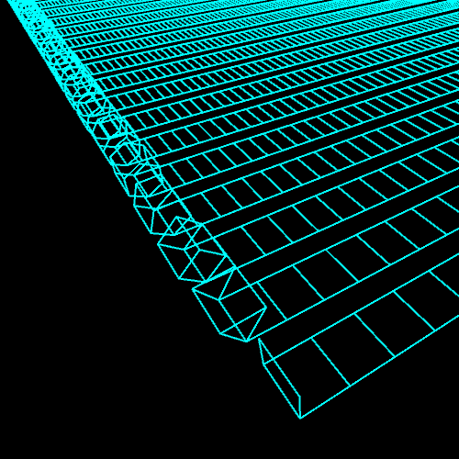

Vince’s Wednesday Webinar

Slide 2
What We will Be covering
Basic Shell Printing
Loops
Simple Maths
Basic User Input
Importing libraries
A fun game to finish it off

Slide 4

for watching
Hope to see you again next week

